Slide 1

A Collaboration between the City, the University, and the Community

Slide 2

Project Mission and Focus
Process and Strategies
Key Highlights of Findings
Overall Conclusions
Moving Forward

Slide 3

Background
Mission
Enhancing and promoting a healthy, creative, and economically sustainable quality of life for Southwest Raleigh.
Goal 1: Measuring Perception
Understand past, current, future conditions
Identify perceptions of residents and businesses of the district
Goal 2: Setting a Baseline
Create a database of assets and perceptions
Identify forces of change versus stabilizing influences
Goal 3: Continuing the Effort: Moving Forward
Provide a mechanism for stakeholders to understand the forces of change influencing SW Raleigh identity.

Slide 4
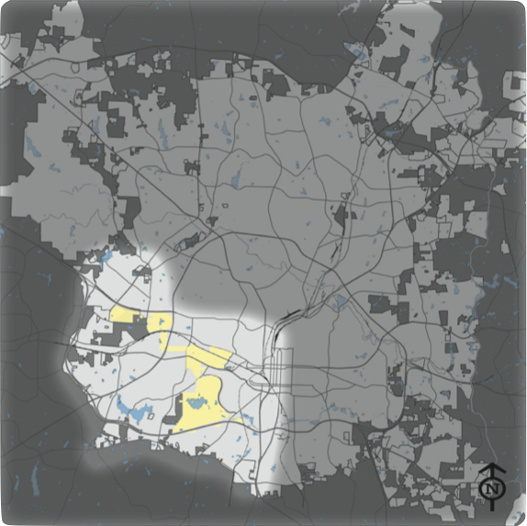
Background
Southwest Raleigh Basics
Area: 33.5 square miles.
23% of Raleigh’s total area.
City of Raleigh, Southwest Raleigh highlighted

Slide 5
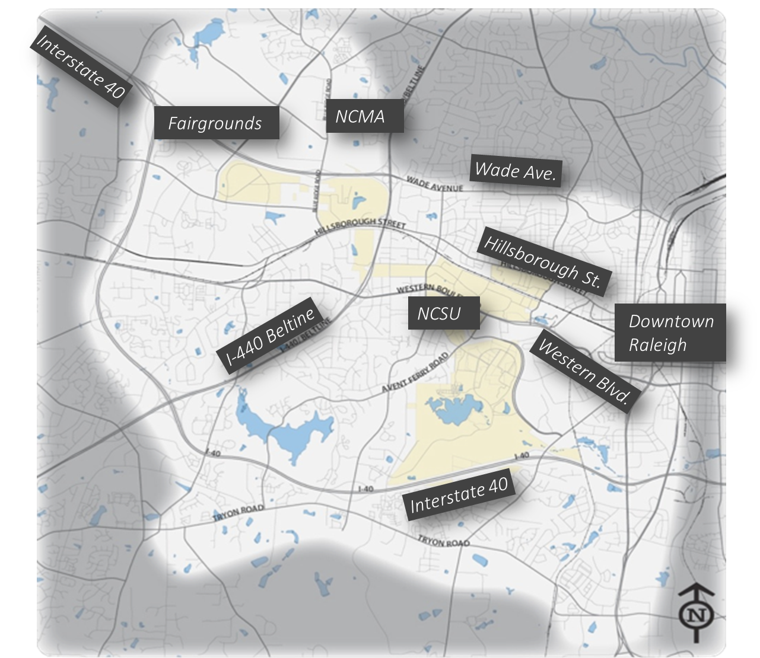
Background
Southwest Raleigh Basics
An extension of Downtown Raleigh.
The neighborhood of NC State University.
Population doubled in the last 40 years: 147,453 in 2010.
From 2000 to 2010, the population increased from 123,719 to 147,453 – over 19%.
Southwest Raleigh

Slide 6
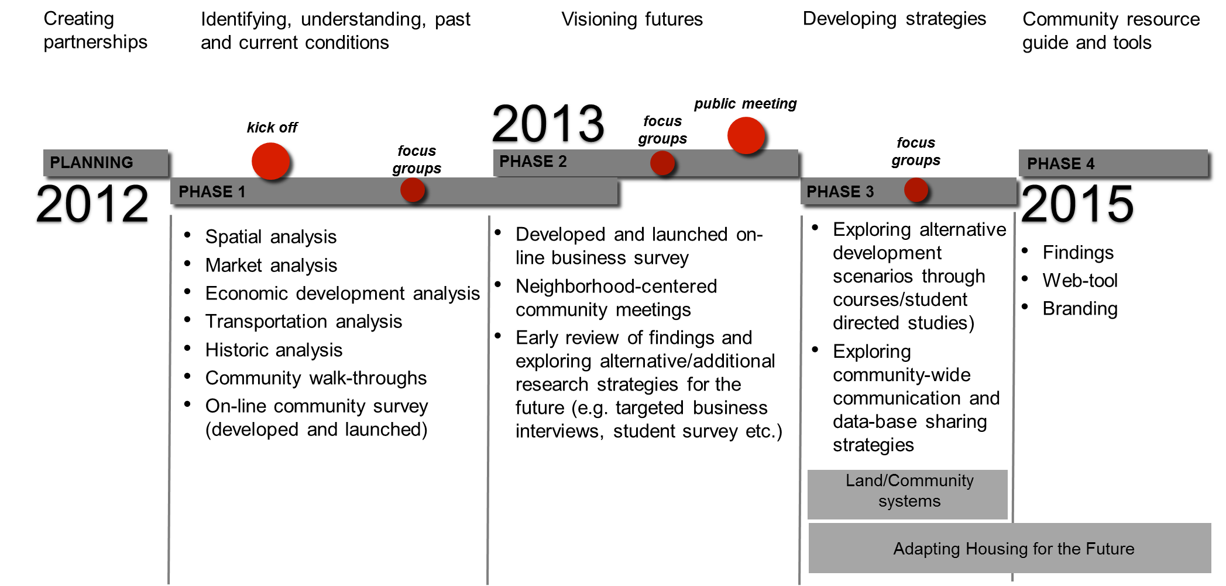
Process
Project Timeline

Slide 7
Approach
Multi-Disciplinary
9 researchers, 18 graduate students, and 6 City Officials and Staff: Architecture, Landscape Architecture, Graphic Design, Community Psychology, Finance and Real Estate, Planning
Community Participation
19 Neighborhood and CAC Meetings, 2 Large Public Forums, 13 Meetings with Community Organizations, 7 Community Events
Integrating Research and Engagement
An Iterative and Inductive Process for Understanding Local Perceptions and Experiences

Slide 8
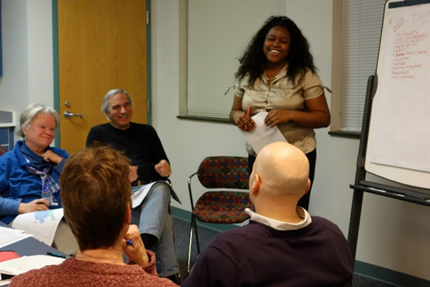
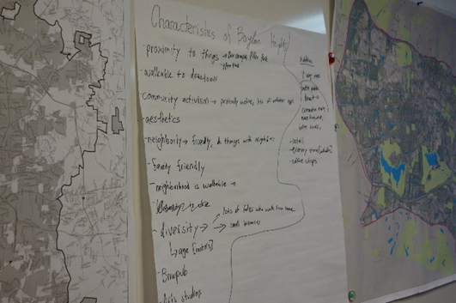
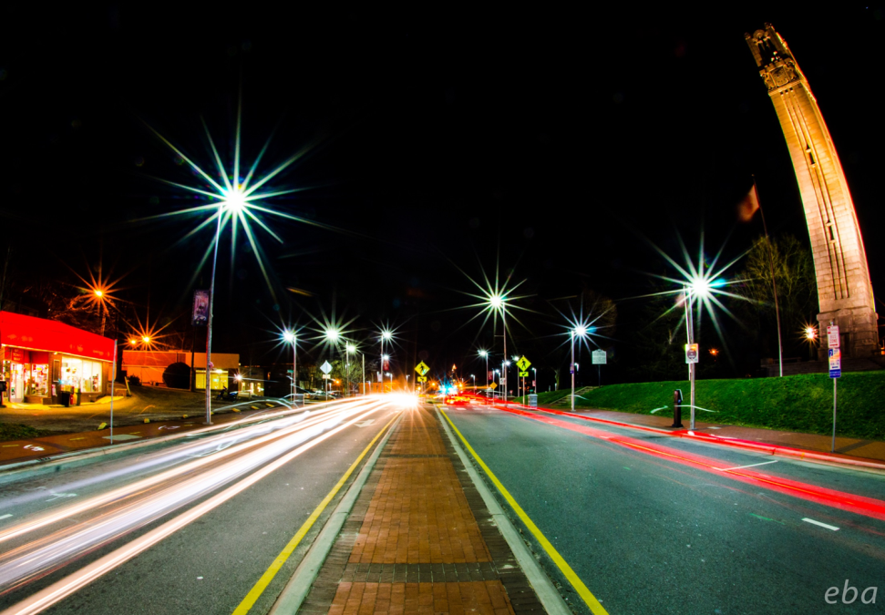
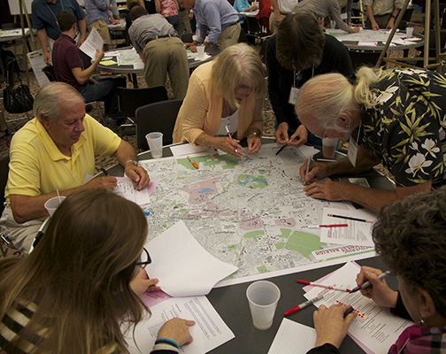
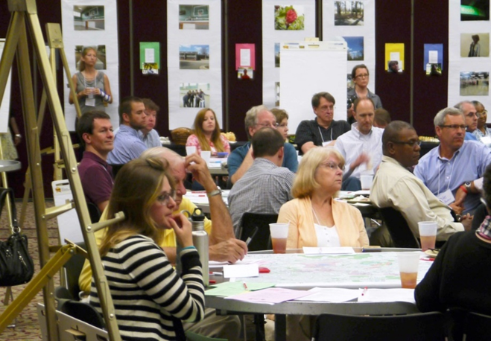
Methodology
Goal 1: Measuring Perception
Focused interviews: Business and community members
Residential Survey – 758 responses
Business Survey – 138 response
Visual Voice
NC State Student Photo Contest
Residential Self-Mapping
  Neighborhood Meetings
  Photo Contest
  Large Public Forums

Slide 9
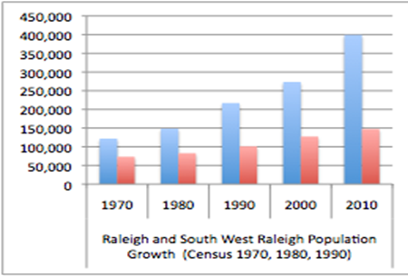
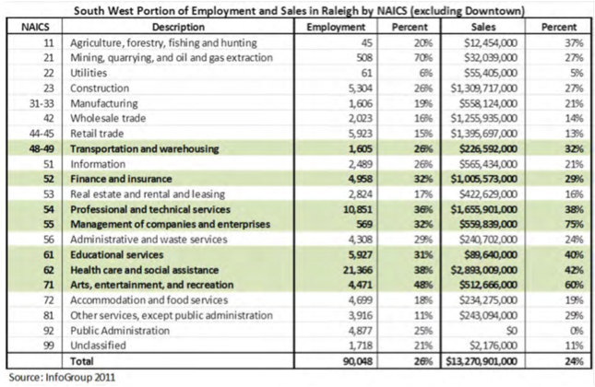
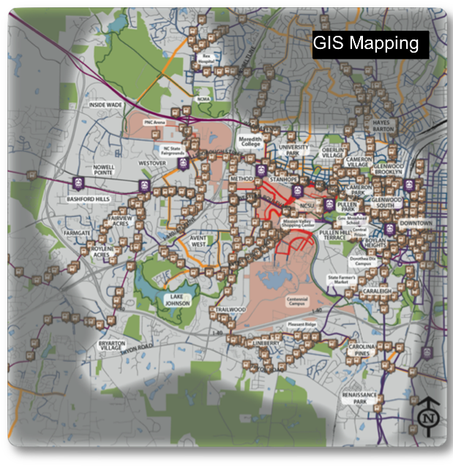
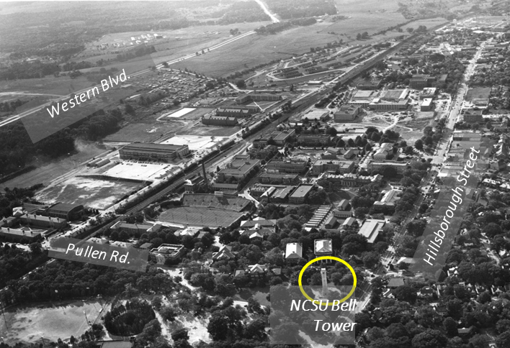
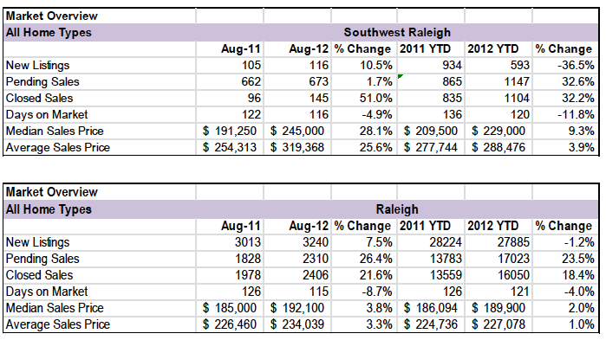
Methodology
Goal 2: Setting a Baseline
Census data
GIS mapping
Economic analysis
Residential real estate analysis
Transportation analysis
Historical analysis and development chronology
  Census Data
  Economic Analysis
  GIS Mapping
  Historical Analysis
  Residential Real Estate Analysis

Slide 10
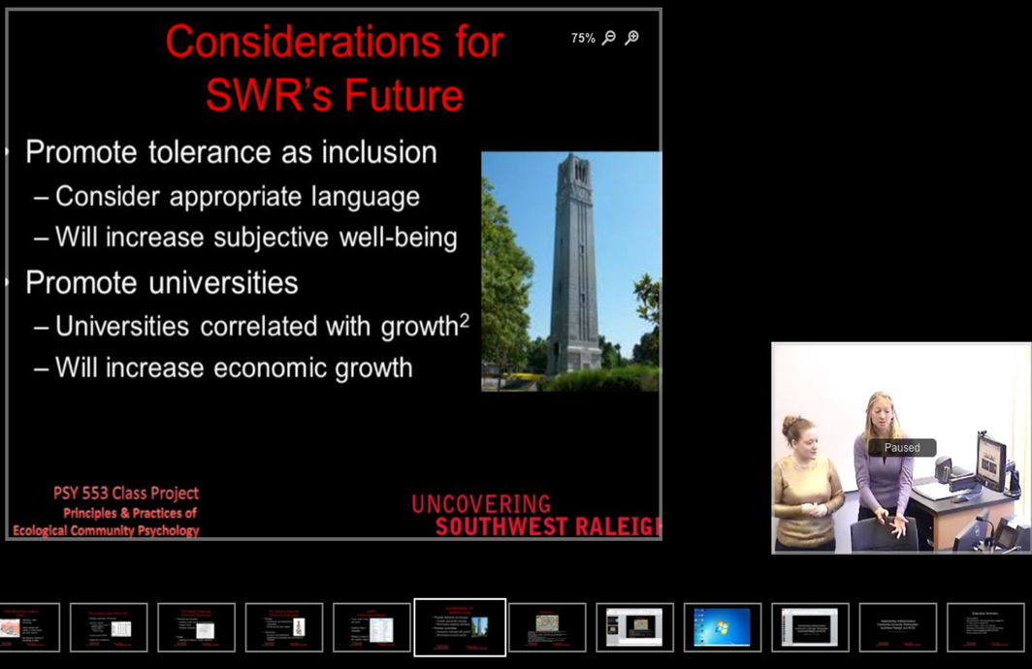
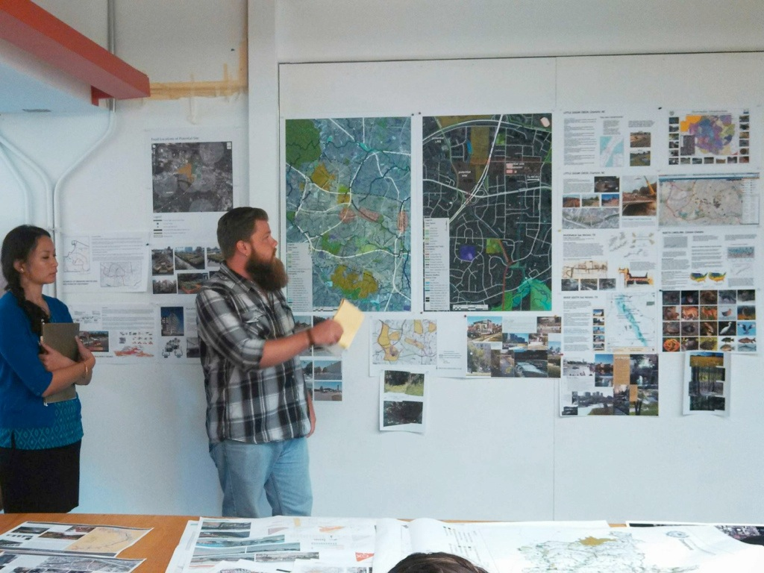
College of Design Studios/Independent Study in Landscape Architecture, Architecture, Graphic Design
College of Humanities and Social Sciences Course – Community Psychology
  Classes – Community Psychology
  Design Studios – Architecture, Landscape Architecture, Graphic Design

Slide 11
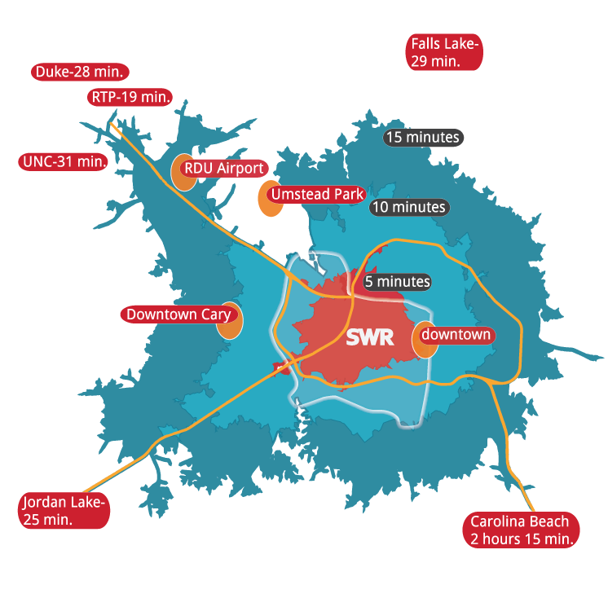
Findings:
Strengths - Connected
The Best Features of Southwest Raleigh
Community Survey Q13, N=758
Connected: access, proximity
Green: Parks, greenways, lakes, trees
Diverse: shopping, restaurants
Campuses: NC State, Meredith College
Sense of Community, stable, friendly
The Arts: music, art, culture
Entertainment: sports, fairgrounds
Diverse: people and culture
Walkable and Bike-able
Residents and Businesses list location, proximity and convenience as major advantages
  Access to downtown, RTP, airport.
  Proximity of NC State and Meredith College.
  Nearby amenities of downtown: Business, culture, government, entertainment.
  Collaborative, innovative environment create connections valuable to the modern economy.
  Remember differences in access and connectedness:
  Between neighborhoods and stakeholder groups

Slide 12
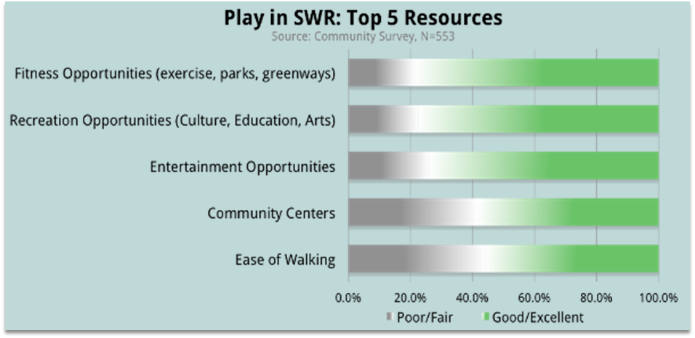
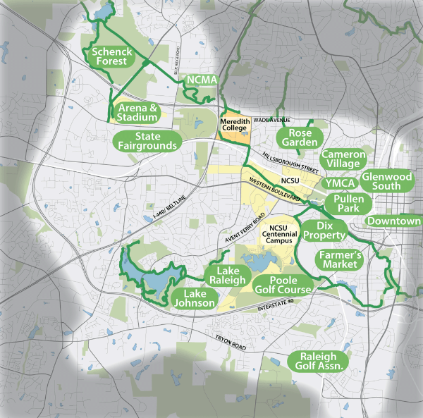
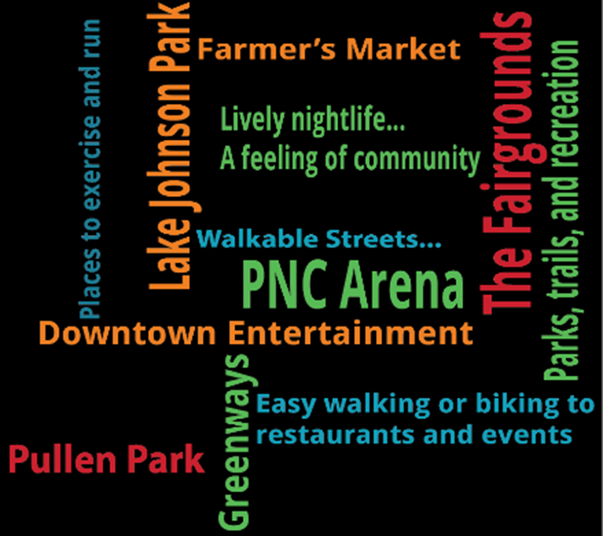
Findings:
Strengths - Green
Both residents and business owners consistently
mentioned parks, greenways, campuses, and arboretum
as major assets in Southwest Raleigh:
    Extensive Greenway System
    Mature Urban Forest
    Arboretum
    Lakes and Parks
    Street Trees
    Campuses

Slide 13
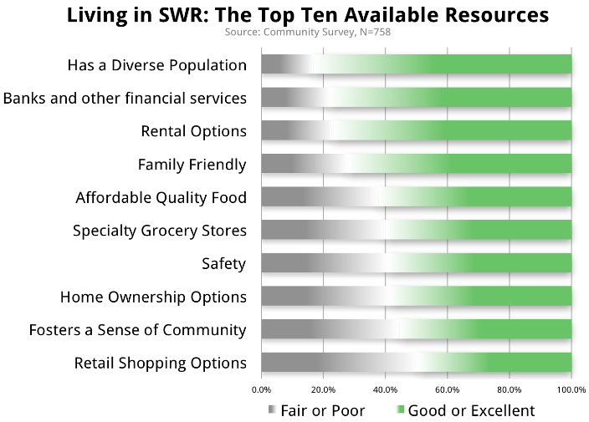
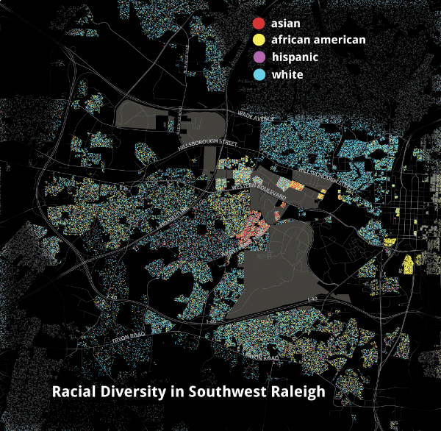
Findings:
Strengths - Diverse
Southwest Raleigh is diverse in many ways
  Ethnicity, culture, age and experience of its residents
  Economic and social opportunities
  Urban to rural environments
  Variety of neighborhoods
  A diversity of shopping, restaurants, and entertainment

Slide 14
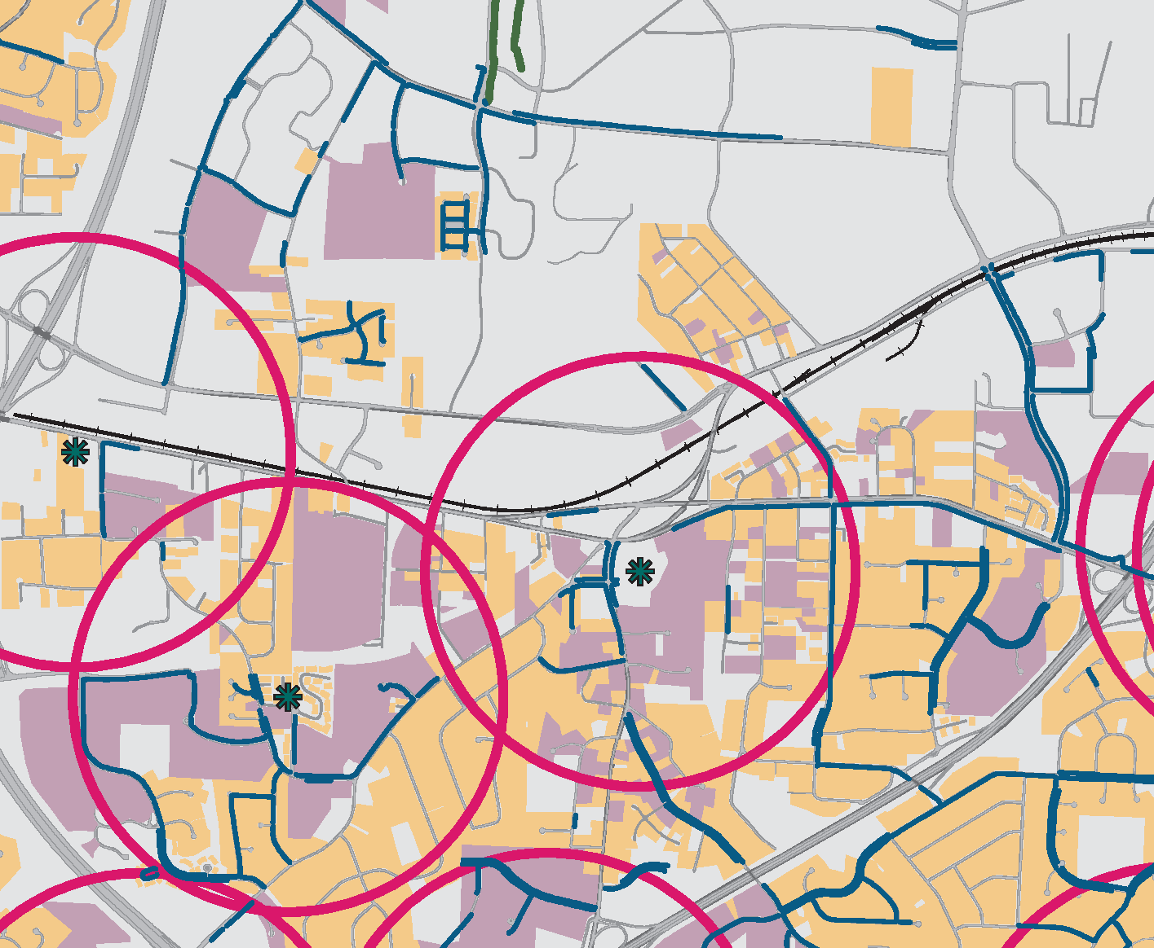
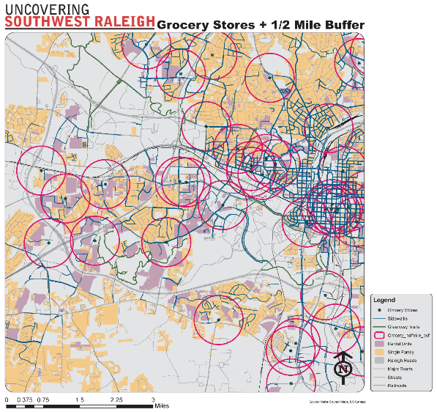
Findings:
Challenges
Important Challenges for Southwest Raleigh
Community Survey Q13.2, N=758
Traffic Safety: More transit, stoplights, crosswalks
Clean-up, Revitalize: Perception of safety, run-down buildings
More Retail and Dining: Grocery and gas stations
Walking and Biking: Sidewalks, bike lanes, lighting, crosswalks
Better development: Denser mixed use, better quality apartments
More Housing Choice: Affordable rentals, townhouses
Sense of Community: Public events, communication
More Green: Parks, greenways, gardens, trees
Which challenges in the community and business surveys and interviews are supported by other types of findings?
Lack of choice in housing, retail, grocery, wholesale and accommodation and food services

Slide 15
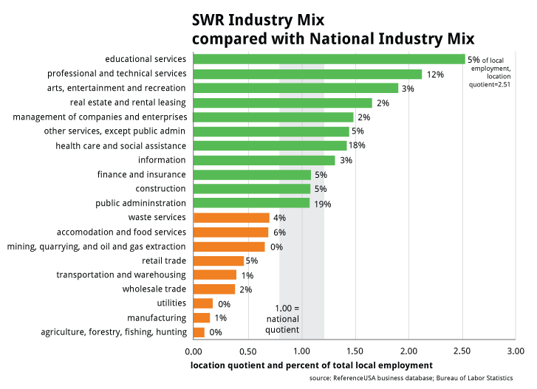
Findings:
Strengths and Challenges
Which perceived strengths and challenges are supported by other evidence?
Availability of amenities
arts, entertainment, education
Availability of basic services
retail, grocery stores, food service

Slide 16
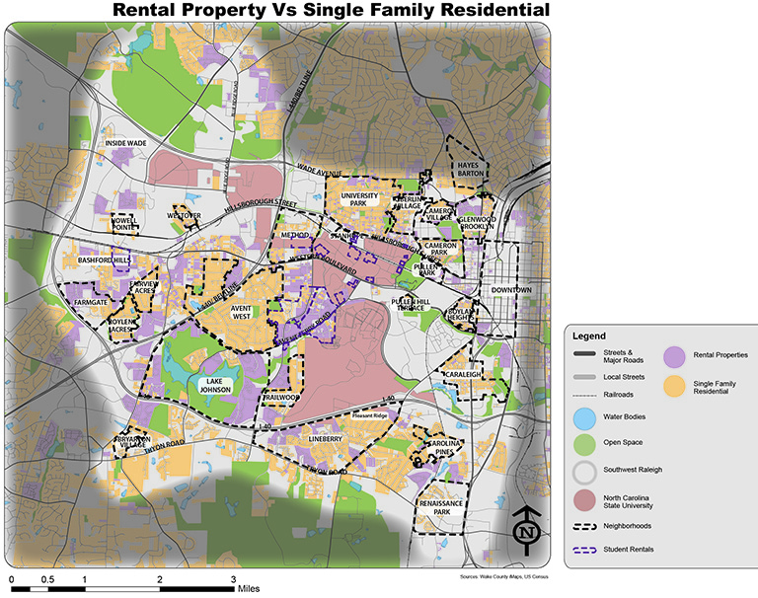
Findings:
Challenges
Which challenges in the surveys and interviews are supported by other types of findings?
Mapping also indicates that there is limited choice in housing

Slide 17
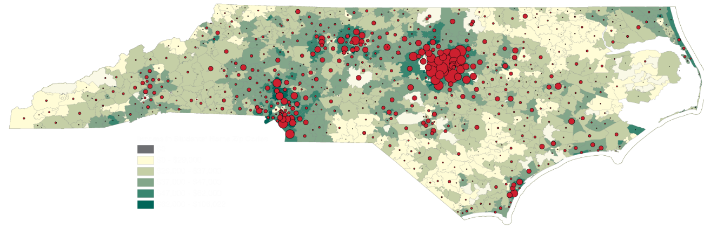
Findings:
Challenges - Misperceptions
Which challenges perceived in the surveys and interviews are not always supported by other findings?
Perceived low income areas in the district may be partly due to seeing student income without full picture of student spending power

Slide 18
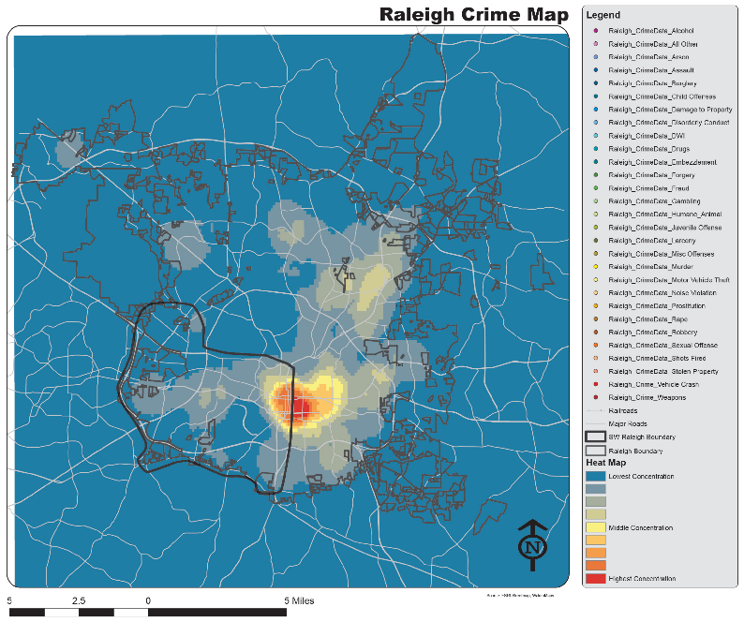
Findings:
Challenges - Misperceptions
Which challenges perceived in the surveys and interviews are not always supported by other findings?
Perceived crime may be more about run-down buildings and graffiti than actual crime statistics.
Are perceived concerns about pedestrian safety or about crime statistics?

Slide 19
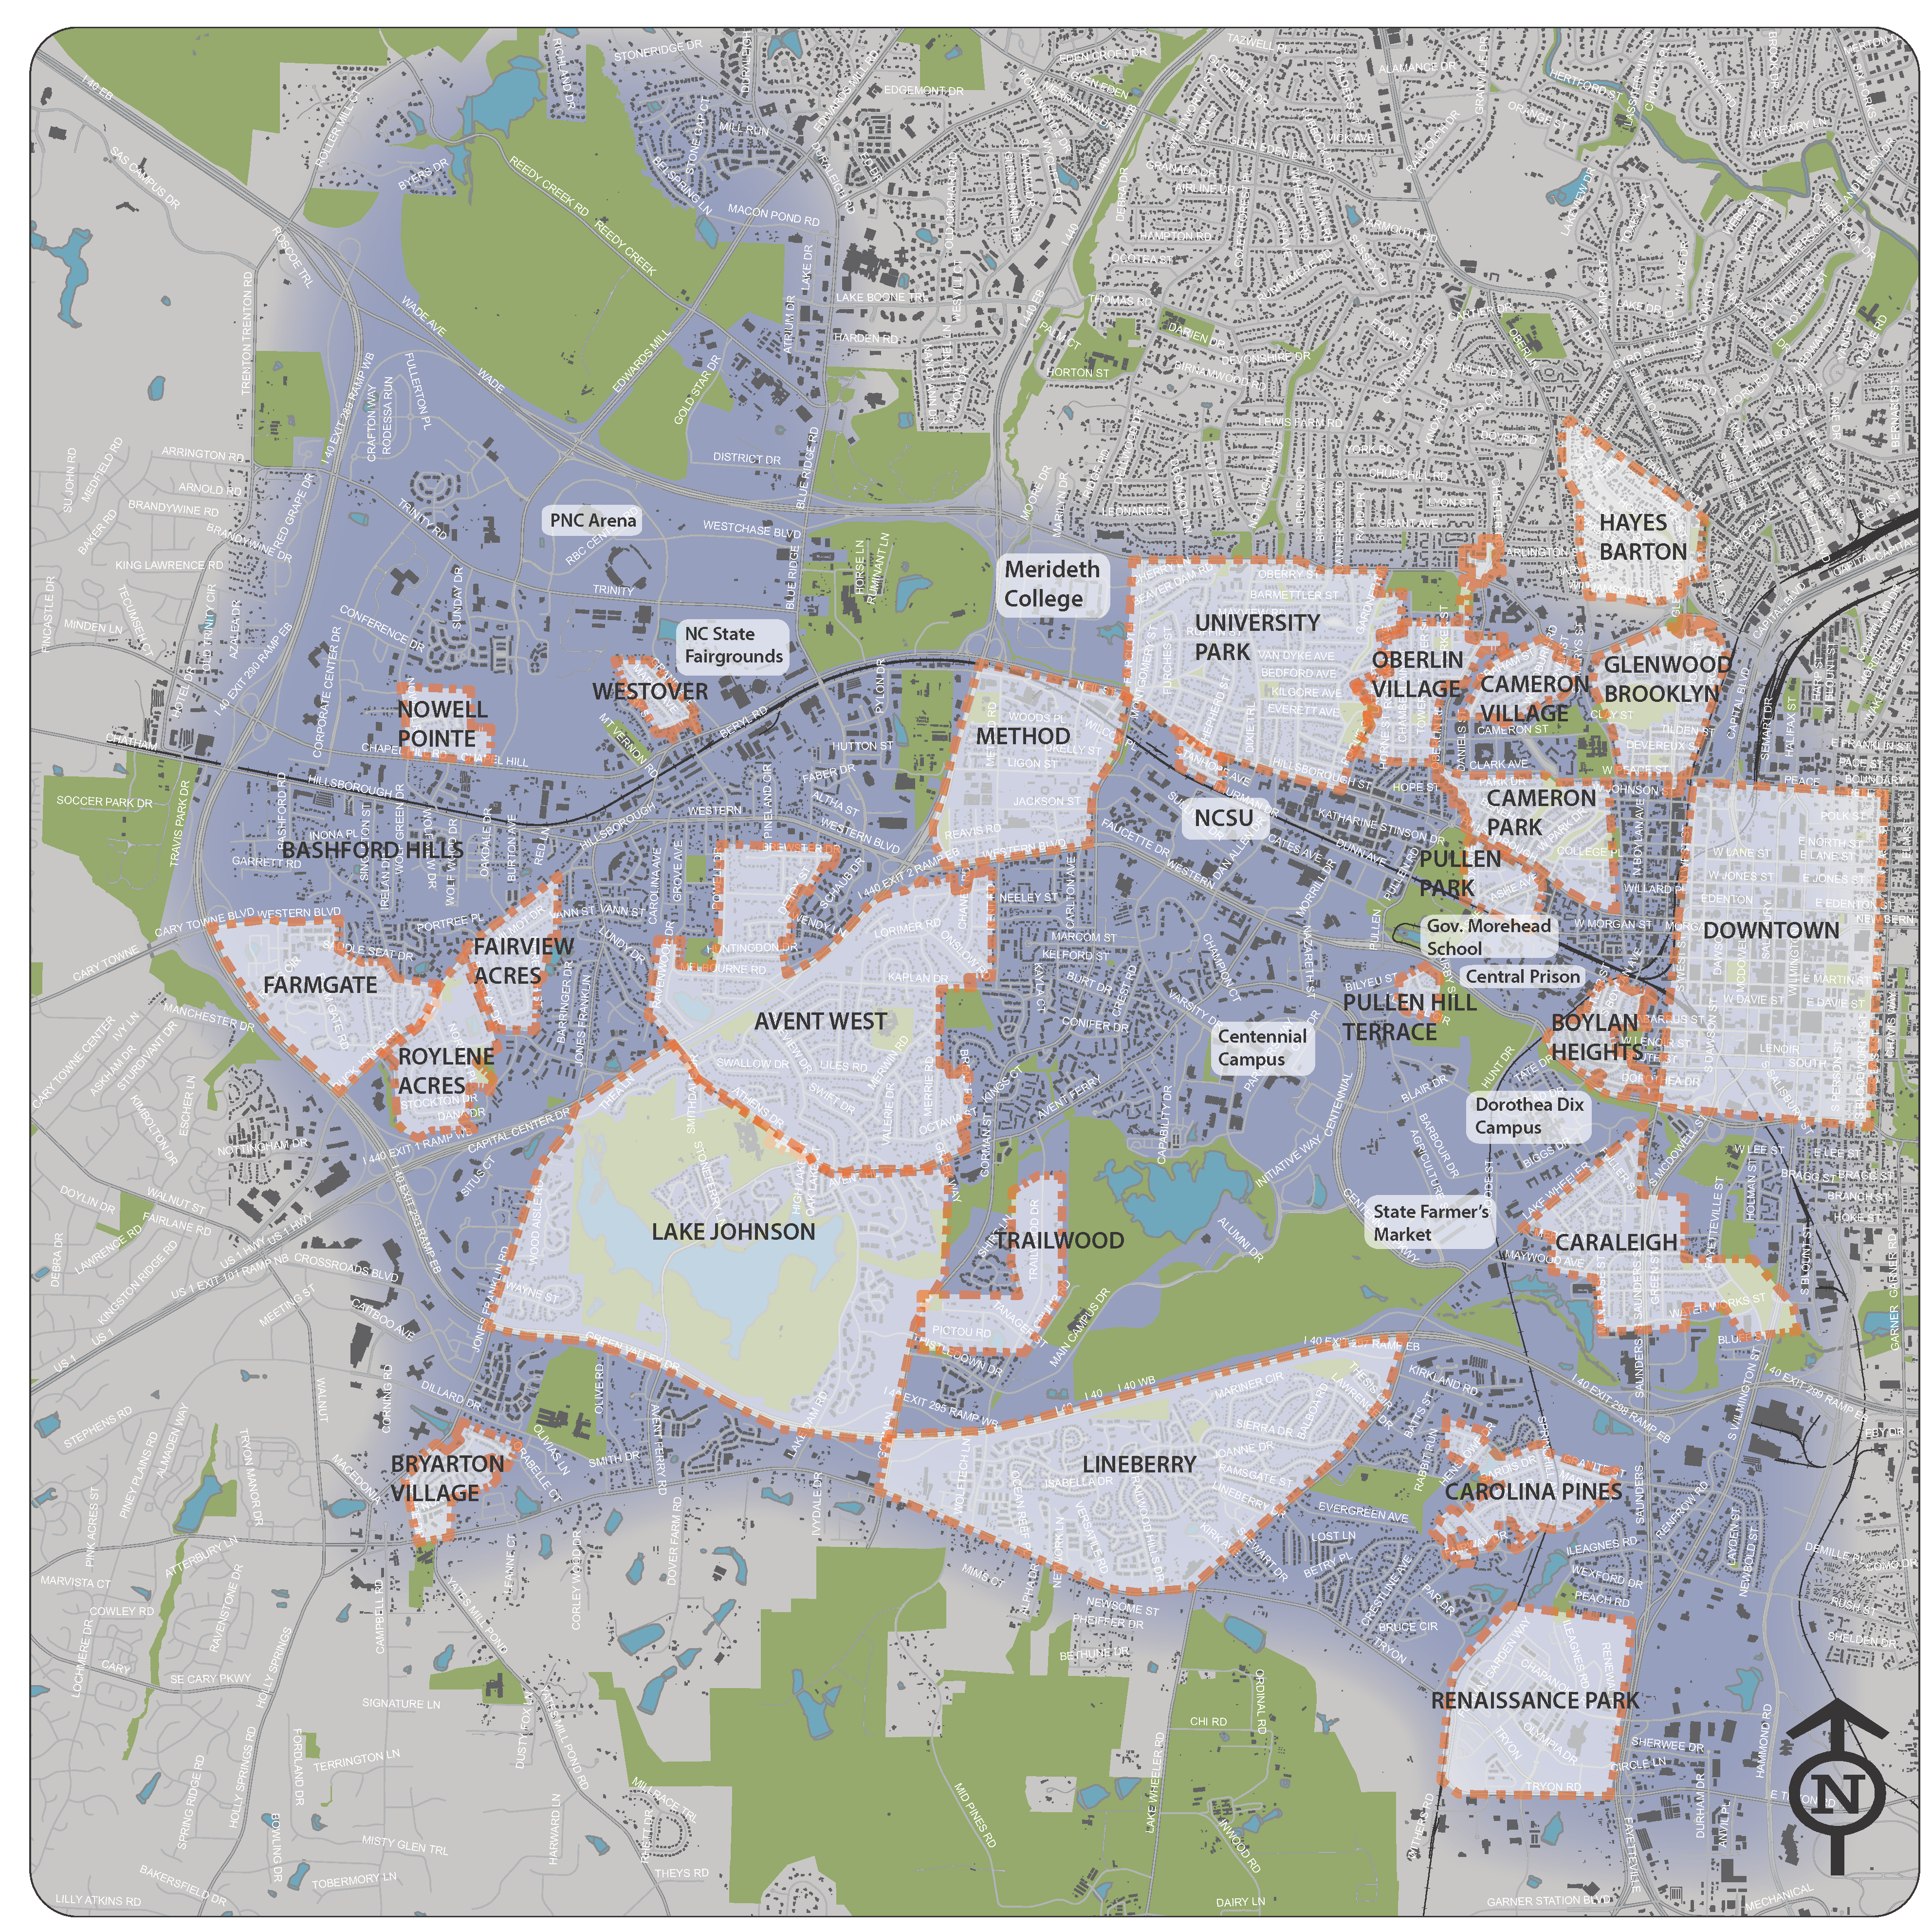
Findings:
Neighborhoods
Of critical importance is understanding that SW Raleigh is a Community of Neighborhoods
Part of the findings are focused on perceptions and setting a baseline at the neighborhood level
Information was collected in:
Community meetings
Interviews
Surveys
Economic analysis
Map data
Community websites

Slide 20
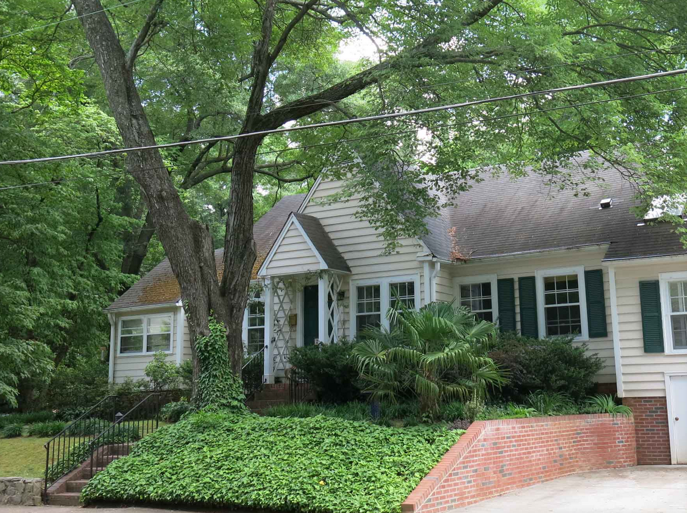
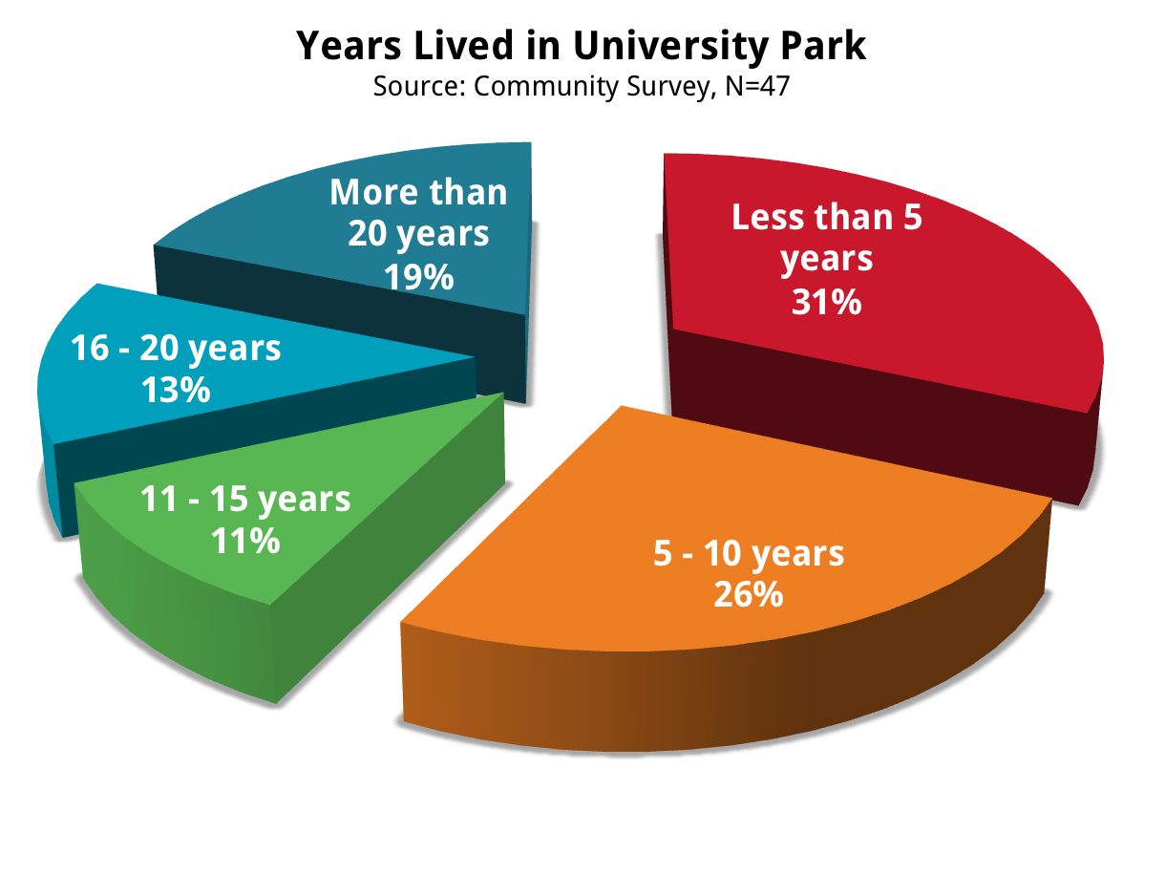
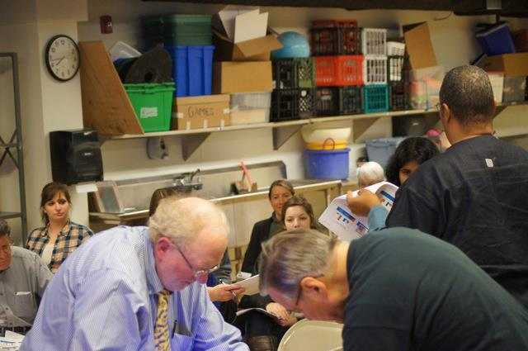
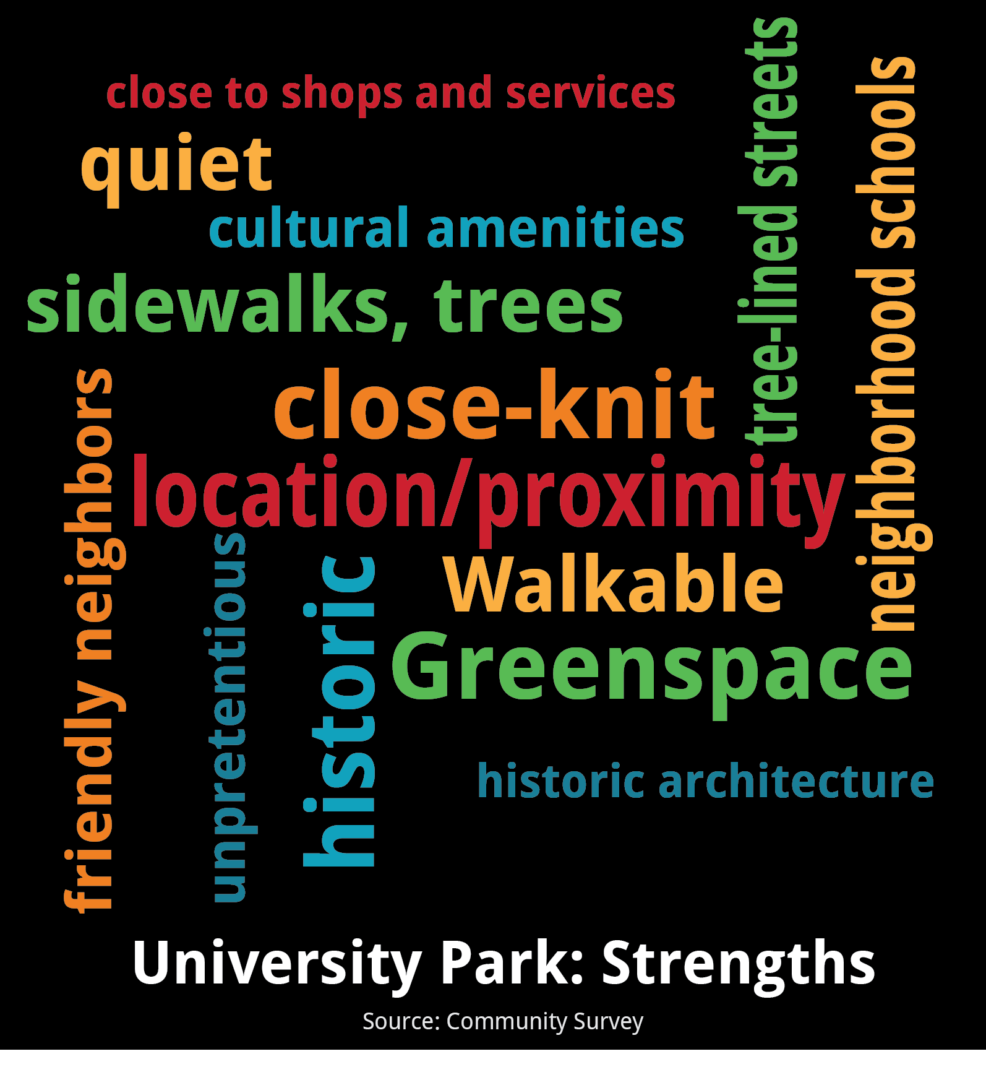
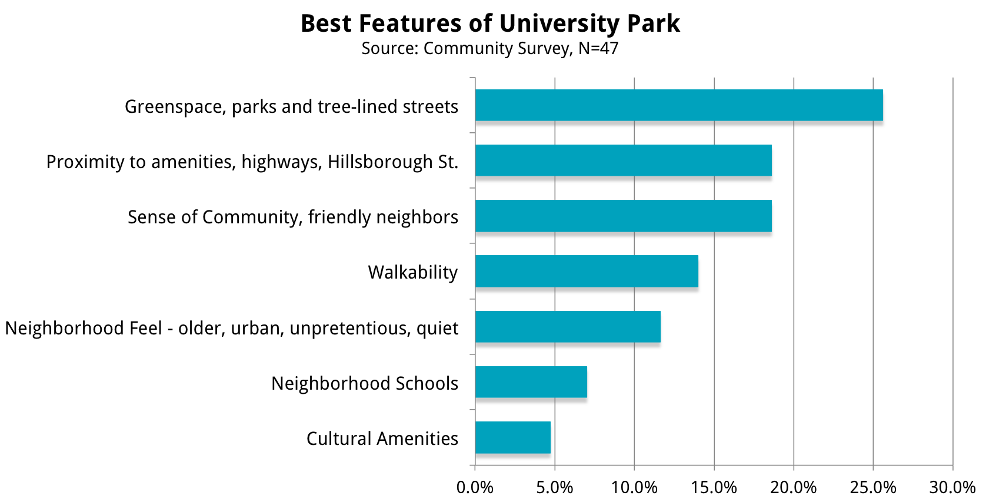
Findings:
University Park

Slide 21
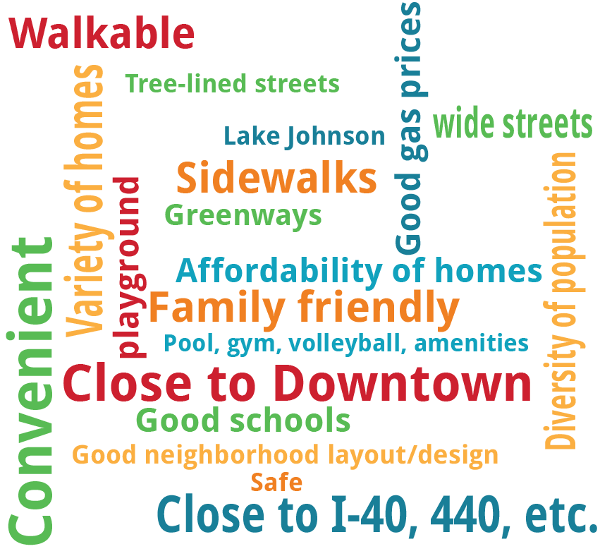
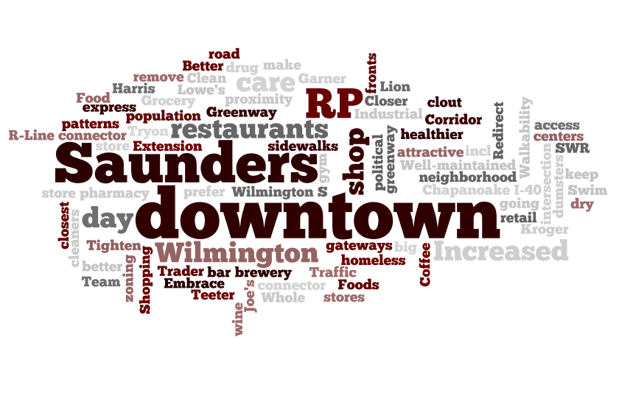
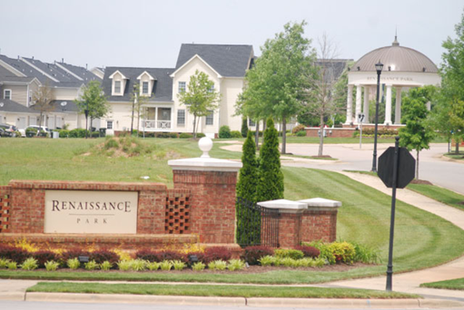
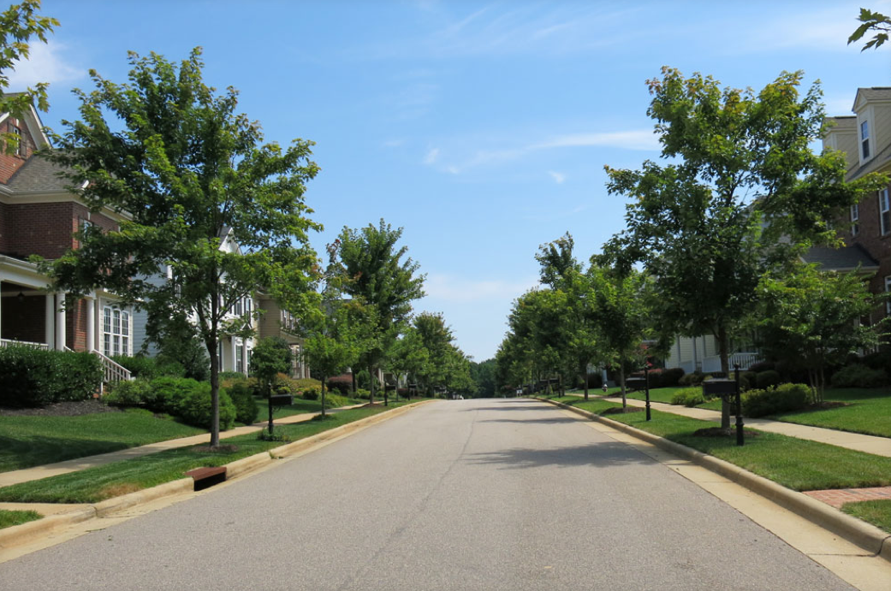
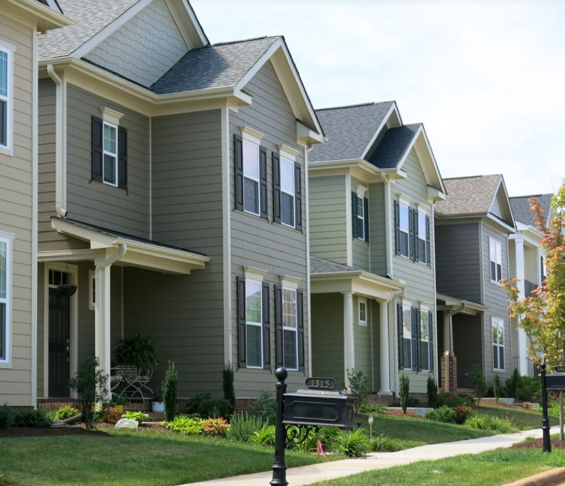
Findings:
Renaissance Park
Renaissance Park: Challenges
Source: Community Meeting
Renaissance Park: Strengths
Source: Community Meeting

Slide 22
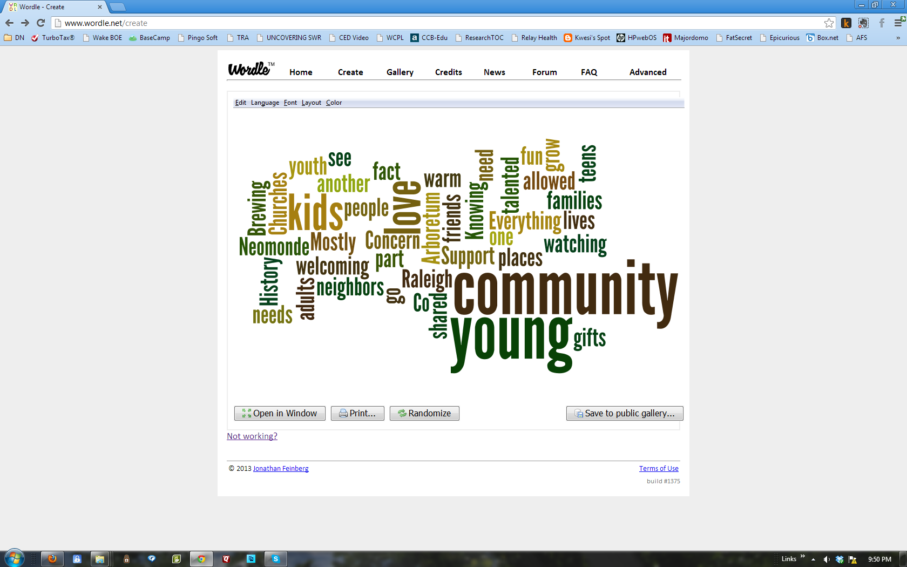
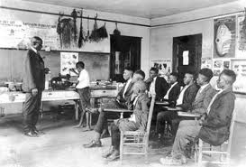
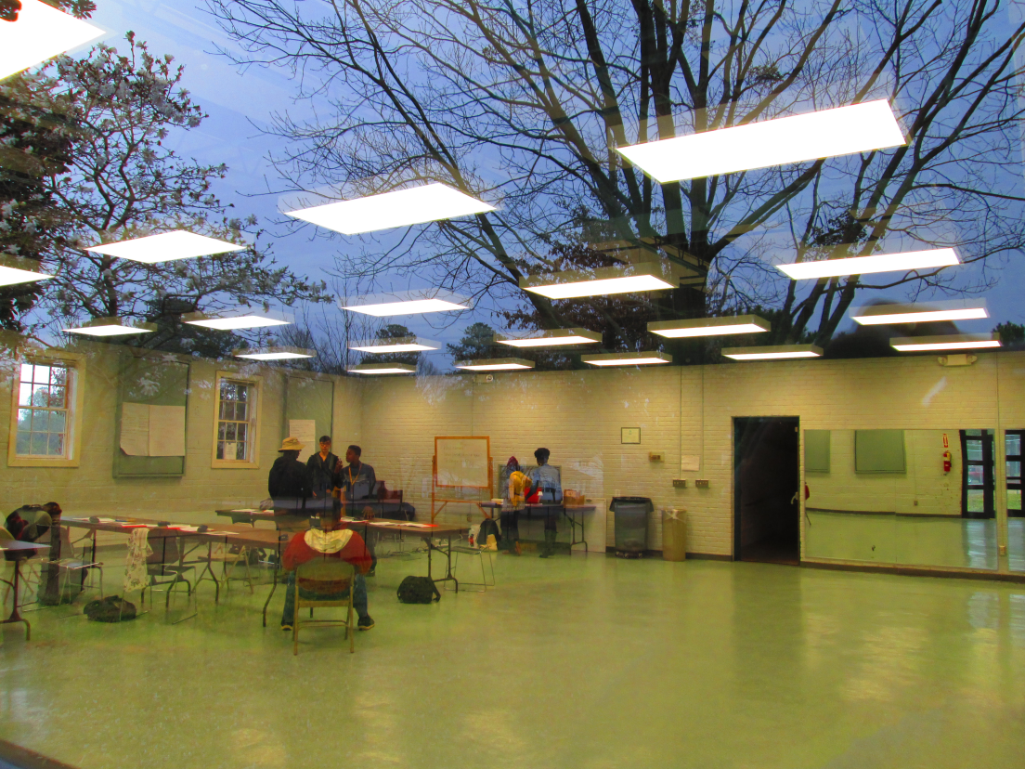
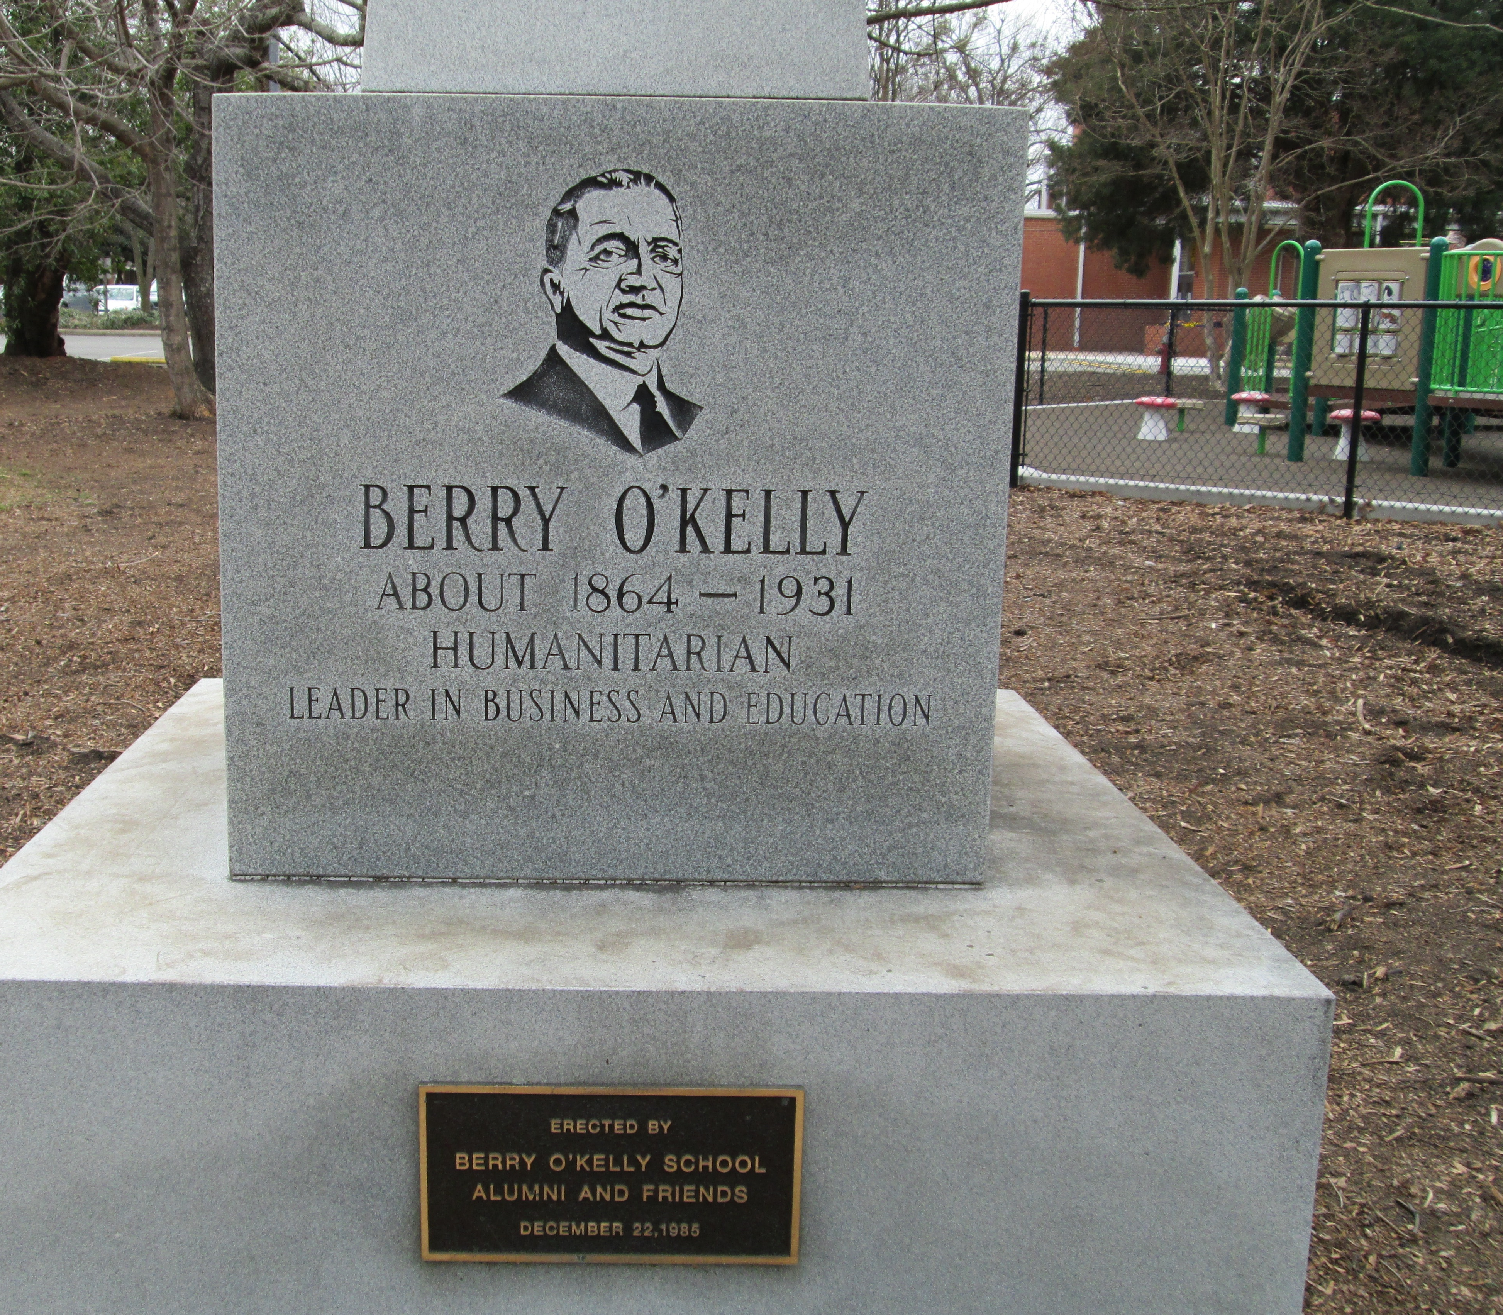
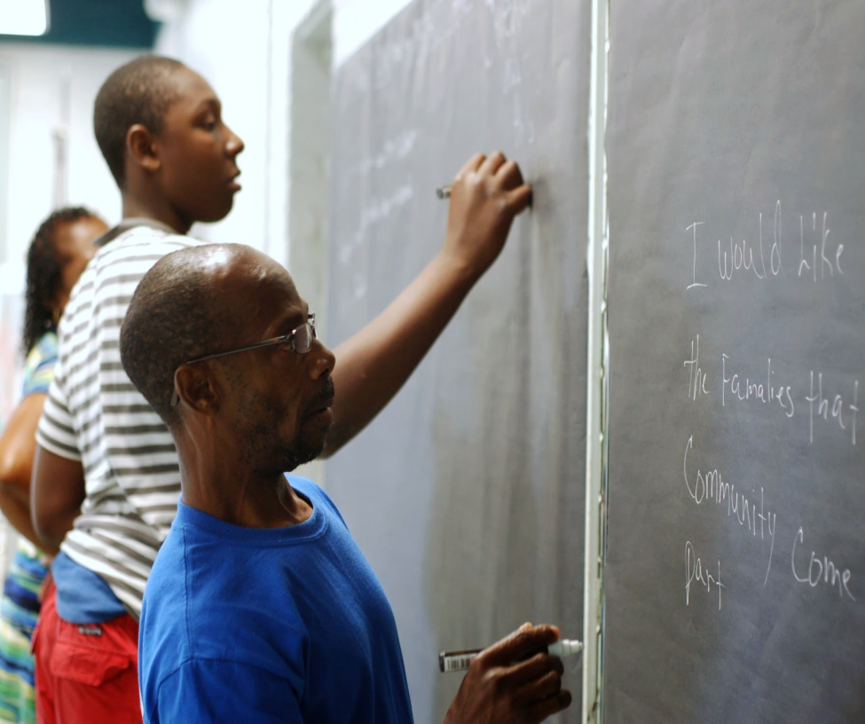
Findings:
Method

Slide 23
Overriding Themes
SW Raleigh Residents
Residents CHOOSE to live in SW Raleigh because:
Strongly Identify With Their Neighborhoods
  Less so with SWR as a whole
Have a generally positive efficacy toward their neighborhoods
Believe negative perceptions and ignorance of the area’s assets are the biggest challenge to promotion and development
Amenities are the greatest need in the areas of:
  Food and dining; Retail and Other commercial development
  More interconnected transportation,
  Improved housing stock
General diversity of the population
  Age
  Race & Ethnicity
  Socio-economic
The character of the neighborhoods
The Old & New SWR
SWR is in transition
Older Neighborhoods
Newer Development
Room for Growth
A great deal to build upon

Slide 24
Community Profile
Cameron Village
lakes
Increase transit
access
convenient
parks
trees
museums
bikable
Reduce traffic
More greenways
proximity
CONNECTED
GREEN
arboretum
walkable
Near downtown
near clients
greenways
farmers market
campuses
Increase walkability
stable
Community of neighborhoods
Economic growth
Strong identity
Healthy and sustainable
Community engagement
friendly neighborhoods
experienced workforce
sense of community
night life
unique
safe
family oriented
vibrant
urban to rural
arts and culture
Improve appearance
creativity
learning community
Increase basic services
innovation
entertainment
High quality of life
Strong destinations
Reduce noise
equity
restaurants
shopping
More housing choices
diverse neighborhoods
DIVERSE
affordability
businesses
ethnicity
Increase job opportunities

Slide 25
Opportunities
City of Raleigh –
Comprehensive Plan Vision Themes
  Economic Prosperity and Equity
  Expanding Housing Choices
  Managing our Growth
  Coordinating Land Use and Transportation
  Greenprint Raleigh - Sustainable Development
  Growing Successful Neighborhoods and Communities
N C State University and Meredith College
  Build Community Connected Profile
  Promote existing community engagement activities
  Engage in Proactive Community Development in SWR
  Employ place-making activities that extend beyond the campus
  Further Embrace Role as Anchor Institution in SWR
Residents and Businesses
  Identify ways to connect across neighborhood boundaries
  Partner with City and Universities to maintain and promote neighborhood strengths
  Employ place-making strategies the build and maintain neighborhood characteristics
Southwest Raleigh

Slide 26
Moving Forward
How do we maintain momentum?
  Continue the partnerships with the community, city, and university
  Build on the investment
  Keep the website current and create interactive interface
  Continue engagement with residents and business community
  Use the model for other areas of the city
Southwest Raleigh

Slide 27
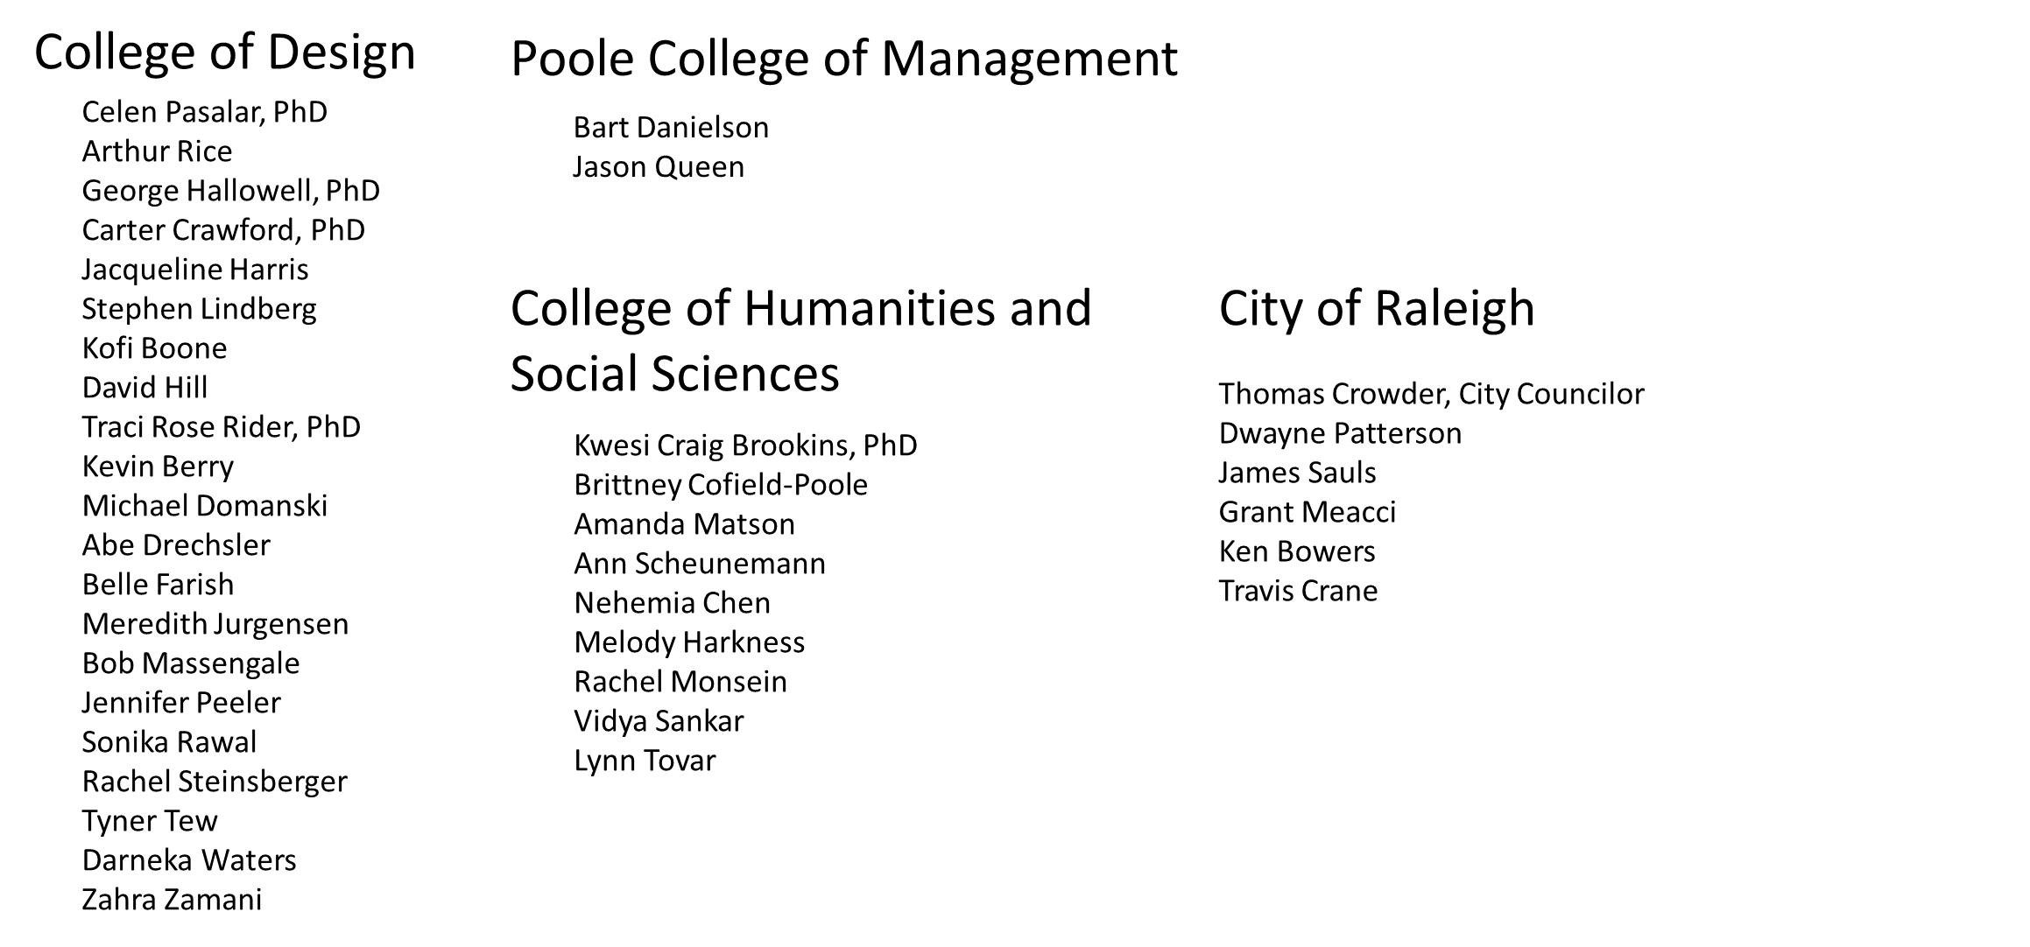
The Team
Residents of Southwest Raleigh

Slide 28
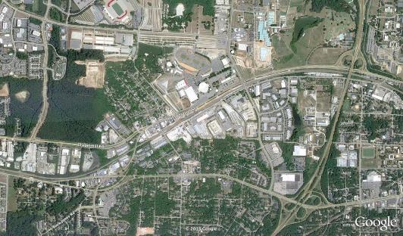
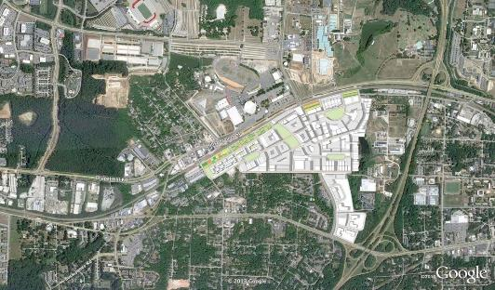
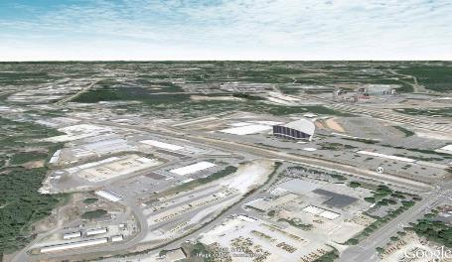
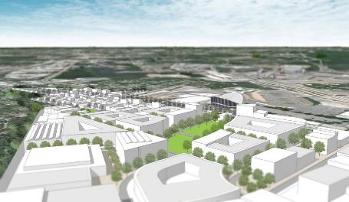
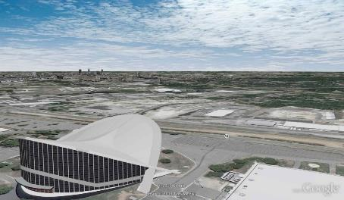
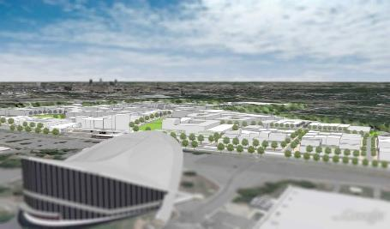
Design Studios
  Design Studio - Landscape Architecture Department -Density and development considerations for the Fairgrounds Light Rail/Mixed Use
  Before
  After
  Before
  After
  Before
  After

Slide 29




Design Studios
  Landscape Architecture Department –
  Mission Valley Density Study Demonstrating a Development Scenario
  Before
  After
  Before
  After

Slide 30


Findings:
Strengths - Connected
The Best Features of Southwest Raleigh
Business Survey Q10.2, N=138
Connected: Location, Proximity, Access
Campuses: NC State, Meredith College
Restaurants, Shops, Entertainment
Amenities: Arboretum, Fairgrounds, Parks
Stable Residential Neighborhoods
Walkable Neighborhoods
Affordable: Office and Homes
Diversity: People, Culture, Businesses

Slide 31













Web-based tool
Reflection of research data

Slide 32




















Web-based tool
Connecting with people

